Slide 1
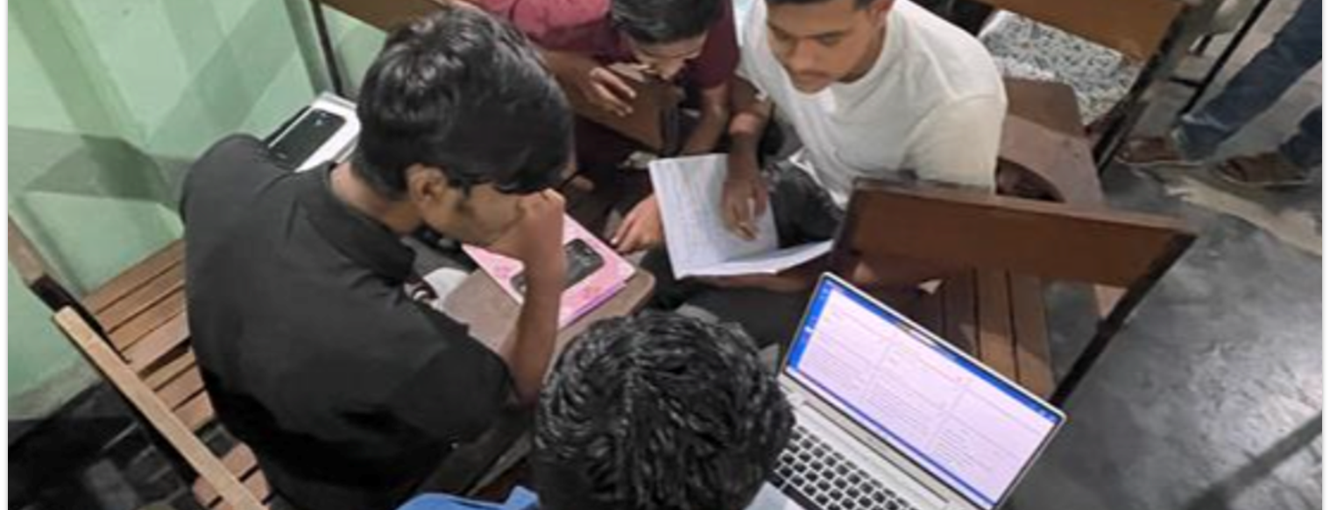
But when anything is exposed by the light, it becomes visible (Eph. 5:13).
All Scripture taken from the English Unlocked Literal Bible (ULB), ©2017, 2022 Wycliffe Associates, Available at https://bibleineverylanguage.org/translations, licensed under the Creative Commons Attribution-ShareAlike 4.0 International License.
The English ULB is based on the unfoldingWord® Literal Text, CC BY-SA 4.0. The original work of the unfoldingWord® Literal Text is available at https://unfoldingword.bible/ult/.
Checking Resources

Slide 2
Translation Goals:
The message is accurate.
The message is clearly understood.
The message is communicated naturally.

Slide 3
WA Checking Resources:
Checking the biblical message and historical context
Bible Commentary
Translation Notes
Checking the language structure and word meanings
Translation Words
Translation Topics
Greek
Words

Slide 4
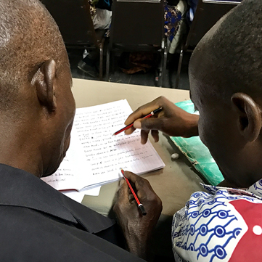
The COBT 8-Step Translation Process
Drafting Steps
Checking Steps
Consume
Verbalize
Chunk
Blind Draft
Self-edit
Peer-edit
Keyword check
Verse-by-verse check

Slide 5
?
Checking Steps
Which resources help with each step?
Self-edit
Peer-edit
Key word check
Verse-by-verse check

Slide 6
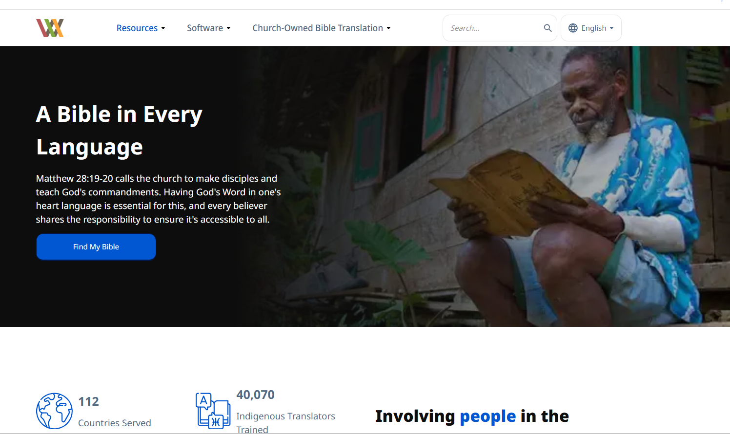
bibleineverylanguage.org

Slide 7
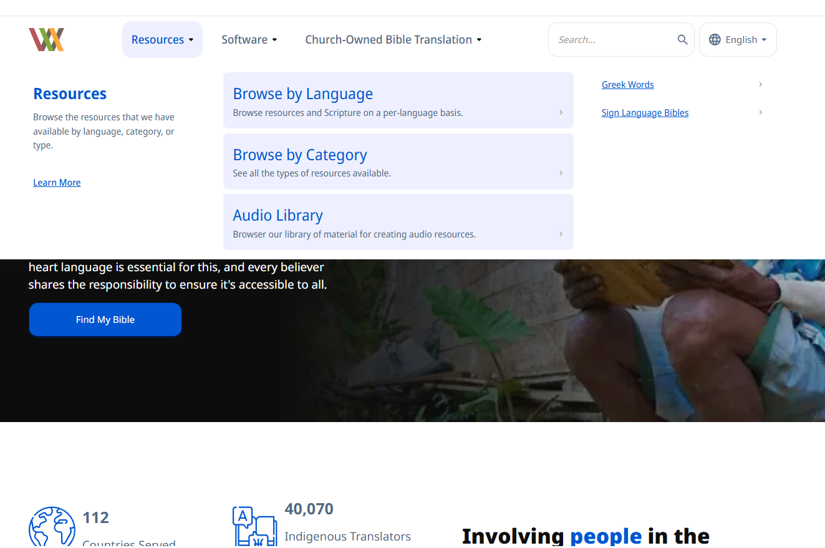
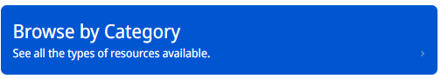
“Resources” → “Browse by Category”

Slide 8
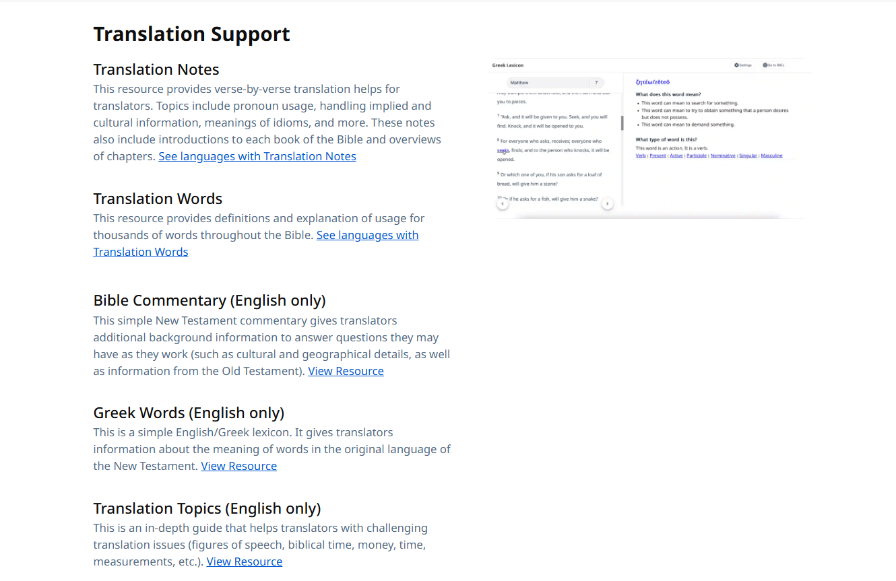
Scroll down → “Translation Support”

Slide 9
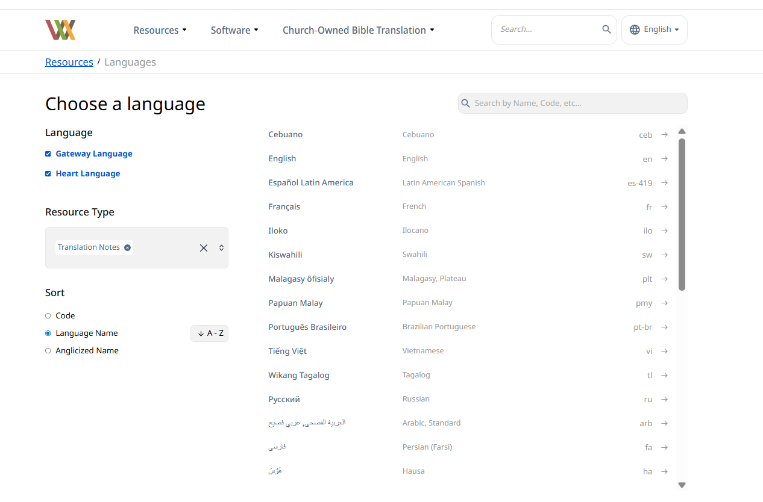
Search for Your Desired Language

Slide 10
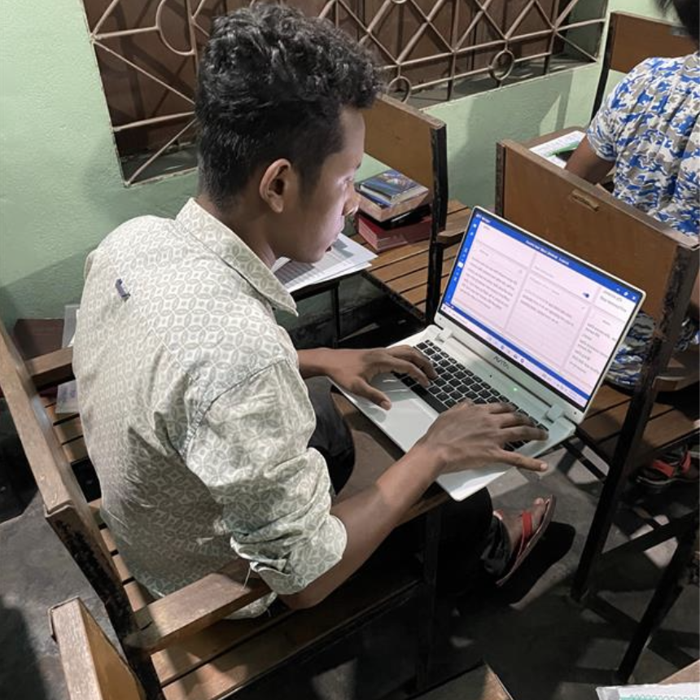


Accessing the Resources
bibleineverylanguage.org
Print out PDFs

Slide 11
Try it
Read Matthew 12:9–14

Slide 12
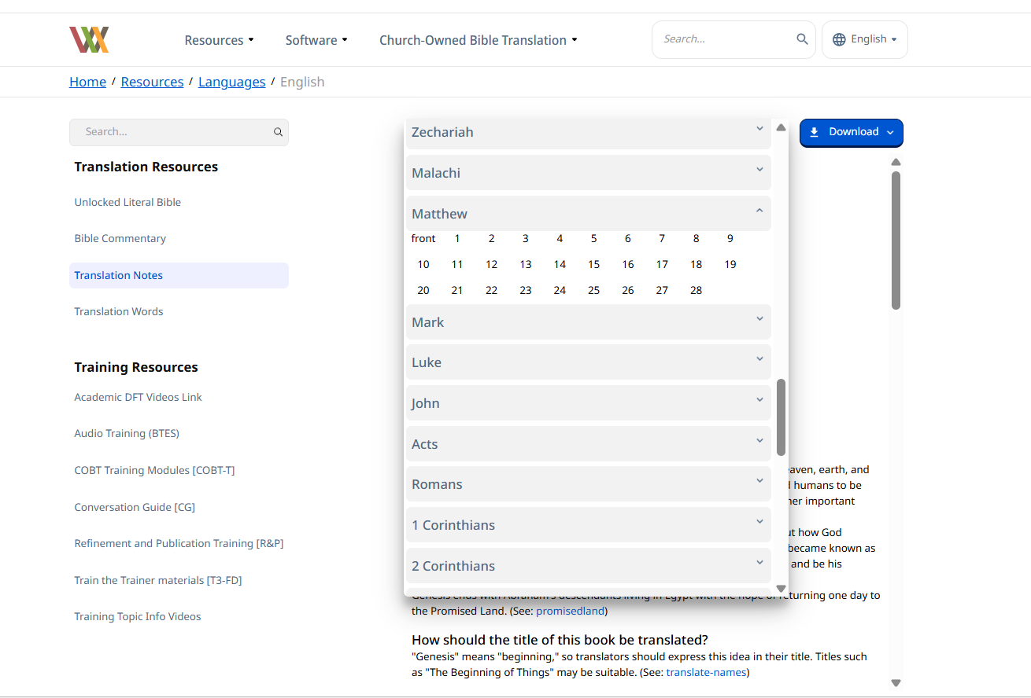
Translation Notes: Navigation Bar

Slide 13
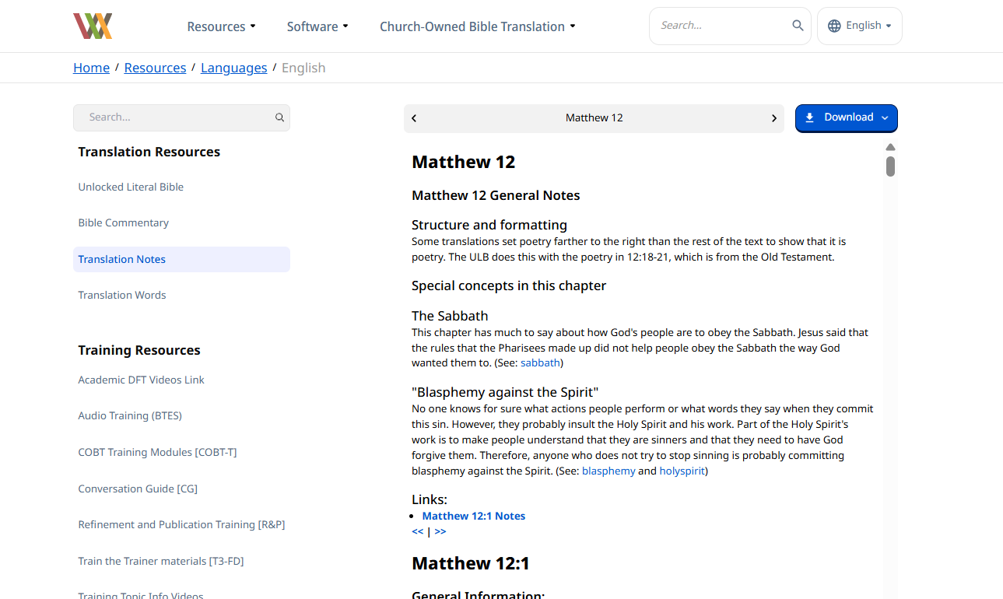
Translation Notes: General Notes (Beginning of Each Chapter)

Slide 14
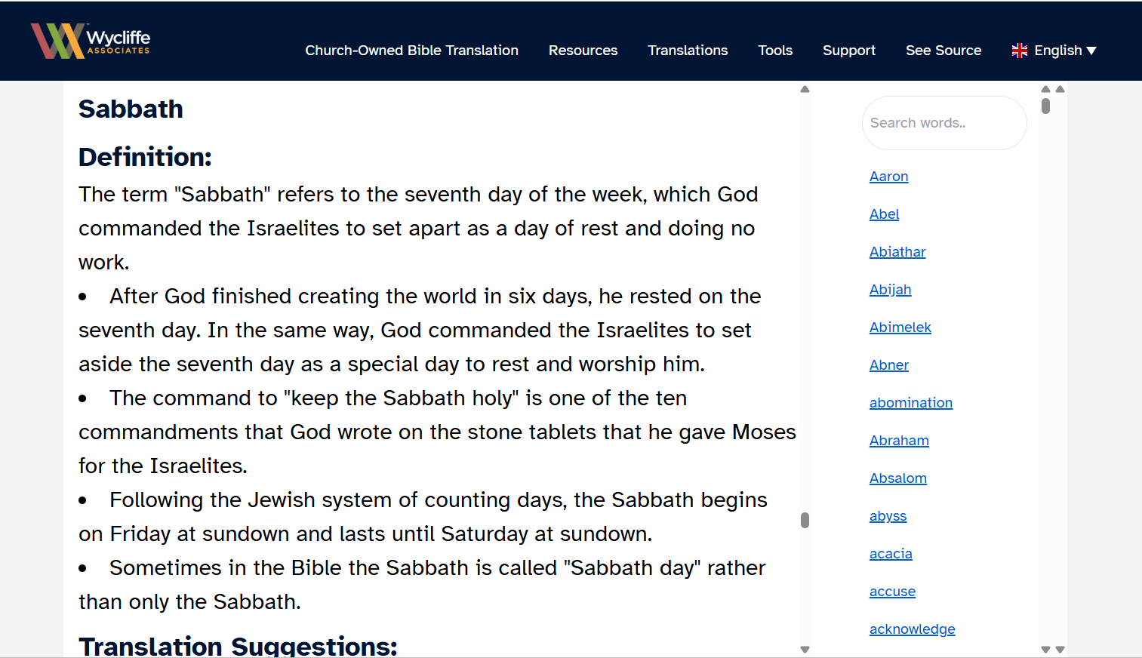
Key Terms (a subset of Key Words)

Slide 15
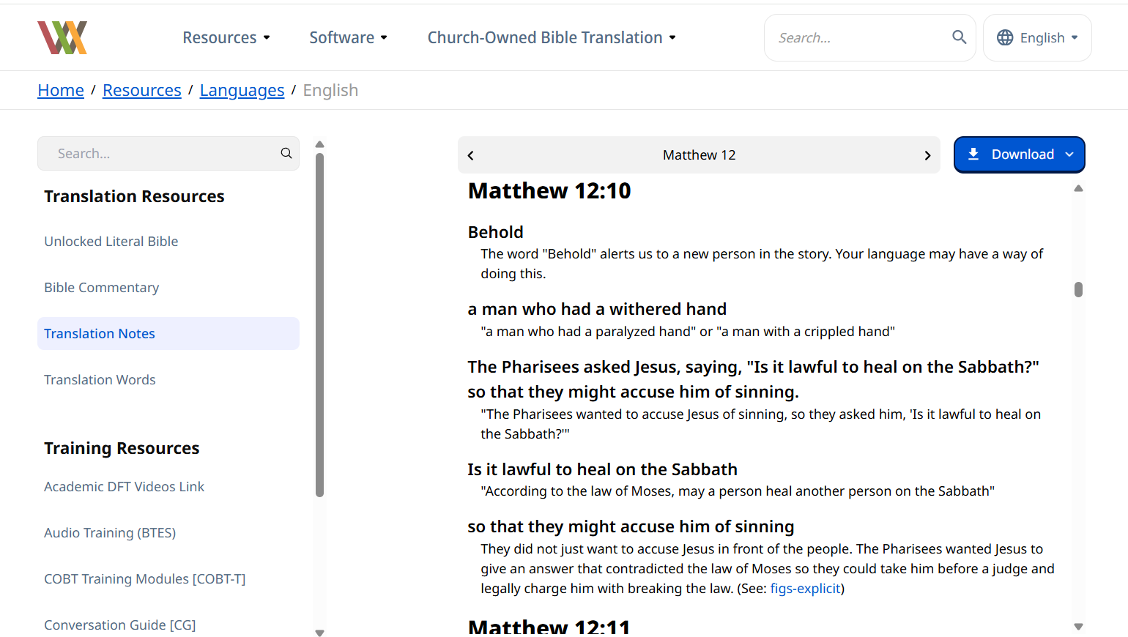
Translation Notes: Verse-by-Verse

Slide 16
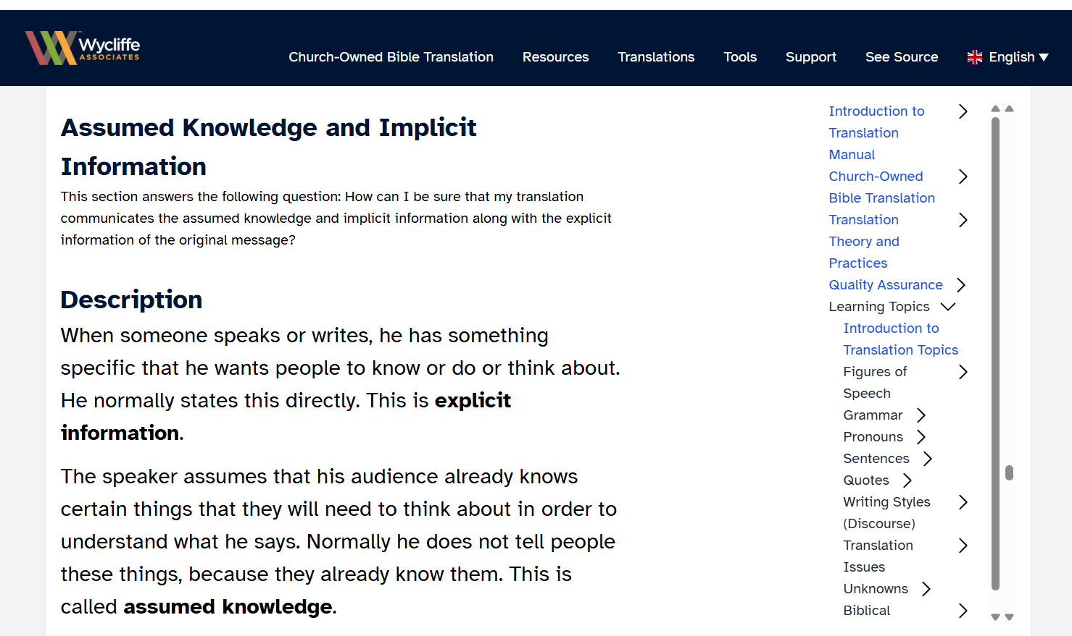
Translation Topics

Slide 17
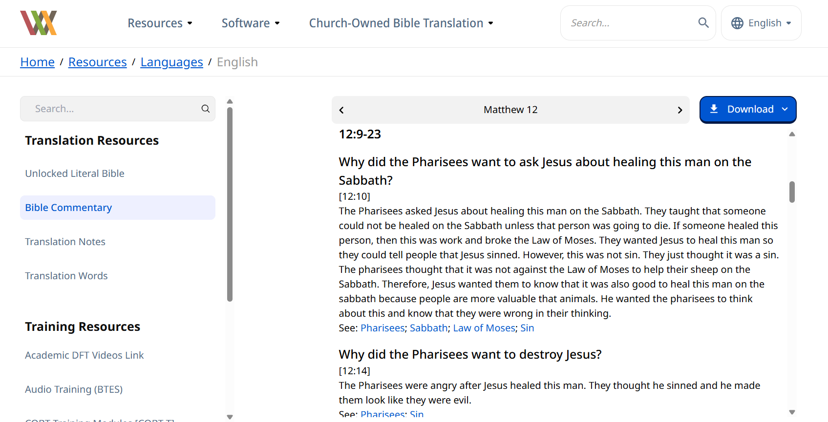
Bible Commentary

Slide 18
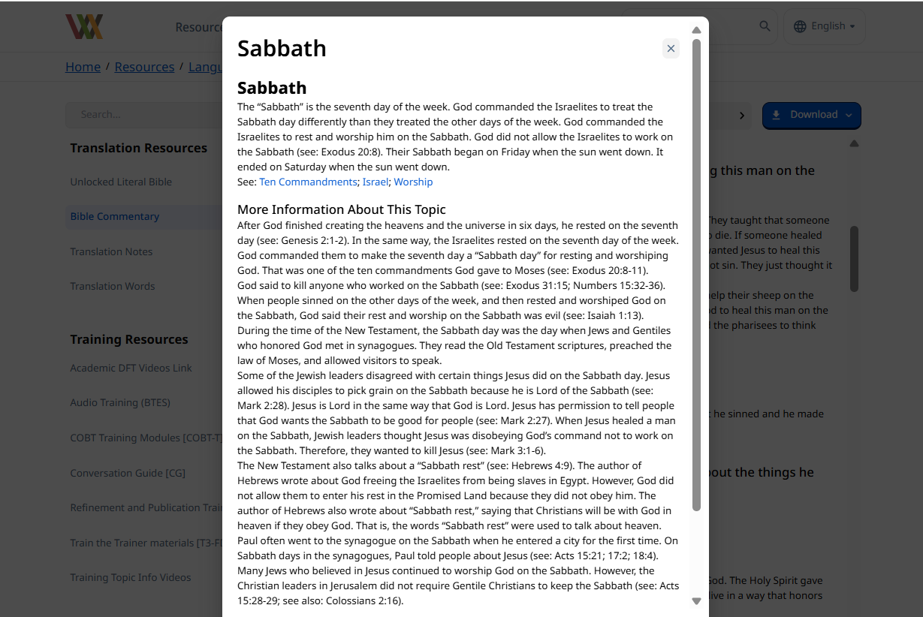
Bible Commentary: Pop-up Articles

Slide 19
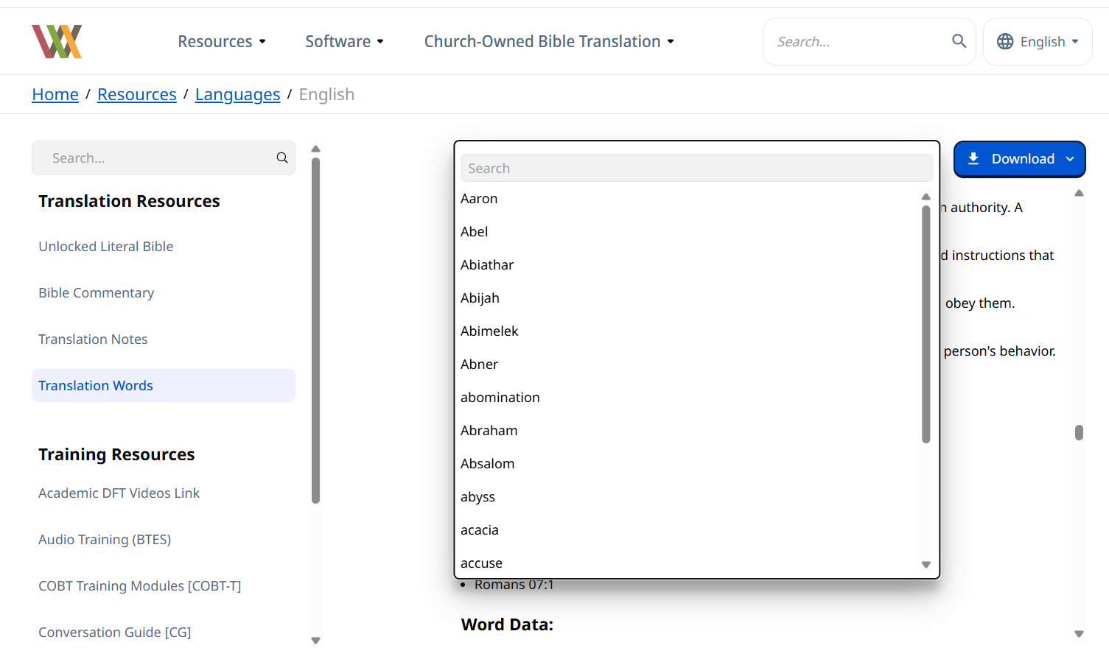
Translation Words: Searching

Slide 20
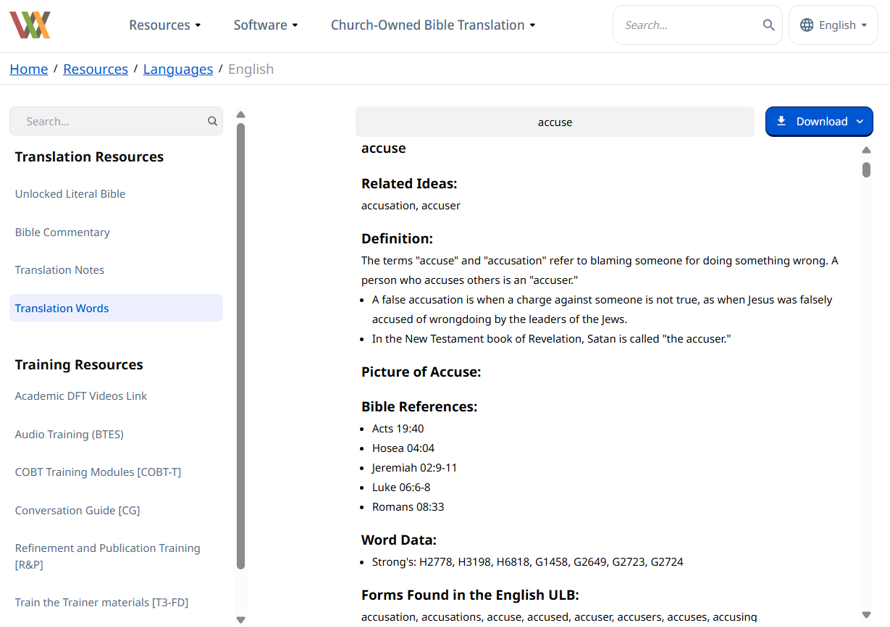
Translation Words

Slide 21
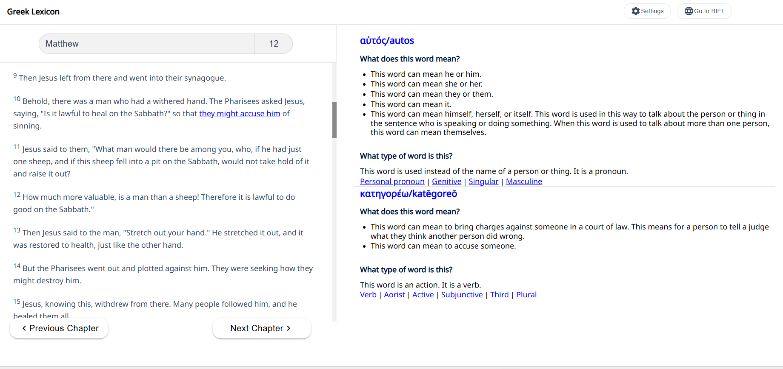
Greek Words: Lexicon

Slide 22
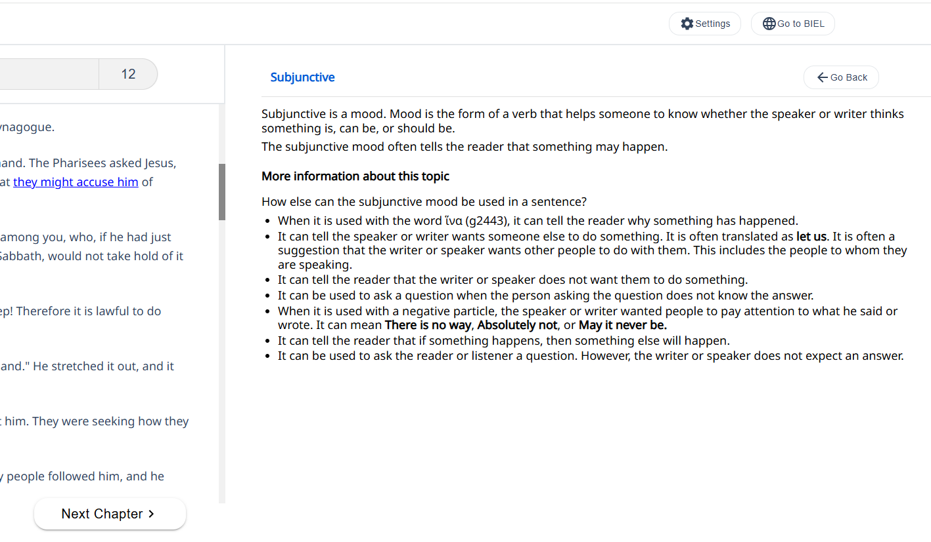
Greek Words: Articles for Grammar

Slide 23
?
Checking Steps
How would you use these resources with each step?
Self-edit
Peer-edit
Key word check
Verse-by-verse check

